Slide 1

第七节 放眼未来 张善友

Slide 2



张善友
首席架构师 | 资深.NET顾问和解决方案专家| 微软最有价值专家| 腾讯云最有价值专家| 华为云最有价值专家 | 超过20年的软件研发经验 | 曾在 腾讯工作11年 | .NET基金会成员
运营微信公众号“dotnet跨平台”和“移动开发和人工智能”，同时积极参与.NET社区开源项目，被尊称为张队长
张善友
微软SWAT特派专家
微软最有价值专家MVP
腾讯云最有价值专家TVP
华为云最有价值专家MVP
.NET基金会会员

Slide 3


.NET
Your platform for building anything
Desktop
Web
Cloud
Mobile
Gaming
IoT
AI
Notes:
You can build anything with .NET.
We’ve made significant investments in .NET over the years as well as unifying the ecosystem to support building literally anything. From desktop to gaming to the cloud, .NET is a general purpose programming platform that enables all kinds of application scenarios. Once you learn one, you can easily pick up another.

Slide 4
ASP.NET Core: Blazor正式登场
Web UI
Services
MVC
Razor Pages
HTTP APIs
SignalR
SPA
Blazor
Worker
gRPC
Notes:
ASP.NET Core comes with everything you need to build beautiful web UI and powerful backend services. The addition of Blazor to ASP.NET Core expands the reach of your .NET web apps to the client.

Slide 5

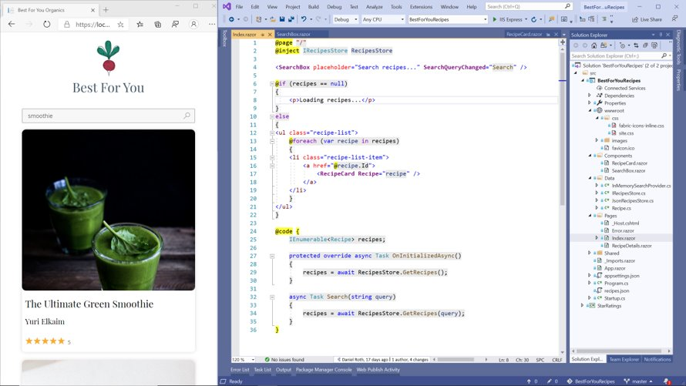
.NET 5 里的Blazor
改进开发者体验
改进WebAssembly
性能
补齐功能特性

Slide 6
.NET Blazor 全栈 web 应用开发
支持 Blazor Server & Blazor WebAssembly
Blazor WebAssembly 加强
现在使用 .NET 5 core 框架库BCL
3X 速度的提升
支持 服务端预渲染 & 依赖延迟加载
组件虚拟化
CSS & JavaScript 隔离
新的组件
快速增长的第三方生态系统和开源控件和工具
Notes:
.NET 5 includes support for building full stack .NET web apps with Blazor Server & Blazor WebAssembly. Blazor WebAssembly apps now use the core framework libraries from .NET 5 giving access to the entire .NET 5 API surface area. Runtime performance in Blazor WebAssembly is two to three times faster than in the previous release. Blazor WebAssembly also now supports server-side prerendering and lazy loading of app dependencies. Other new Blazor features includes support for component virtualization, CSS isolation, JavaScript isolation, capturing JavaScript object refs, new components for radio button groups and file inputs, setting the UI focus, and many other improvements for building client-side web apps with C# instead of JavaScript.

Slide 7
.NET 5 里的Blazor 特性
CSS Isolation
Auto-refresh
Packages auto-add their own CSS/JS
Better debugging
InputFile support
Virtualization
Azure Static Web Apps Integration
Notes:
.NET 5 includes support for building full stack .NET web apps with Blazor Server & Blazor WebAssembly. Blazor WebAssembly apps now use the core framework libraries from .NET 5 giving access to the entire .NET 5 API surface area. Runtime performance in Blazor WebAssembly is two to three times faster than in the previous release. Blazor WebAssembly also now supports server-side prerendering and lazy loading of app dependencies. Other new Blazor features includes support for component virtualization, CSS isolation, JavaScript isolation, capturing JavaScript object refs, new components for radio button groups and file inputs, setting the UI focus, and many other improvements for building client-side web apps with C# instead of JavaScript.

Slide 8
.NET 5 里的Blazor 特性
Demo
https://github.com/bluzorhub/blazoract
Notes:
Blazoract is an interactive notebook user interface implemented in Blazor WebAssembly. It combines some features in Blazor released in .NET 5, such as virtualization and CSS isolation, and includes a kernel backend powered by .NET Interactive.

Slide 9

OSS Partners for .NET 5 – Thank you!
OPEN SOURCE
Ant Design Blazor
ImageSharp
And many more…
bUnit
Live Reload Middleware for ASP.NET Core
Blazm
MatBlazor
Blazor Extensions
NuGet Package Explorer
Blazored
Oqtane
Blazorise
Reactive Extensions
BlazorStrap
Swashbuckle
Cake
Uno Platform
IdentityServer
Notes:
We also want to call out specific open source projects that had a big impact making the .NET 5 release awesome, as well as those projects that are built on .NET 5 today.
Of course, there are many more .NET open source projects under the .NET Foundation that make the .NET ecosystem a great place to be.
THANK YOU!!
<CLICK>

Slide 10

性能提升

Slide 11
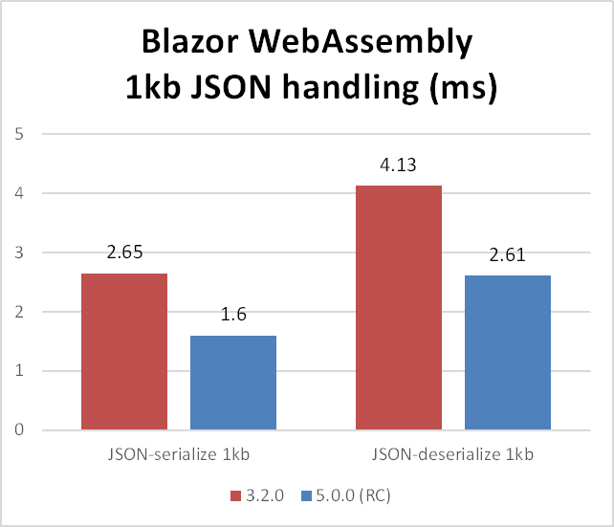
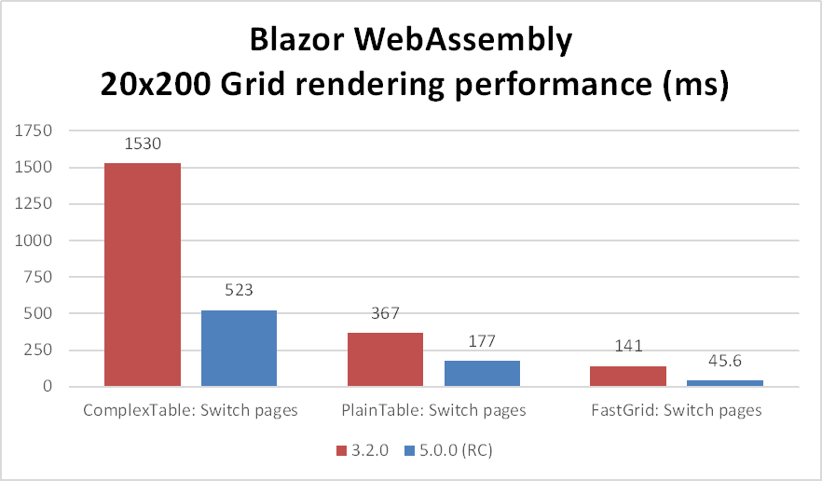
改进 JSON 序列化和反序列化
改进对复杂组件的渲染(e.g. grids)
改进字符串比较。字典查找等等
Notes:
Steve to speak

Slide 12

Protected Browser Storage
@inject ProtectedLocalStorage storage
<p>Current count: @currentCount</p>
<button @onclick="IncrementCount">Increment</button>
@code {
int? count;
private async LoadCount() {
var result = await storage.GetAsync<int>("count");
count = result.Success ? result.Value : 0;
}
private async IncrementCount() {
await storage.SetAsync("count", ++count);
}
}
Notes:
Steve to speak

Slide 13
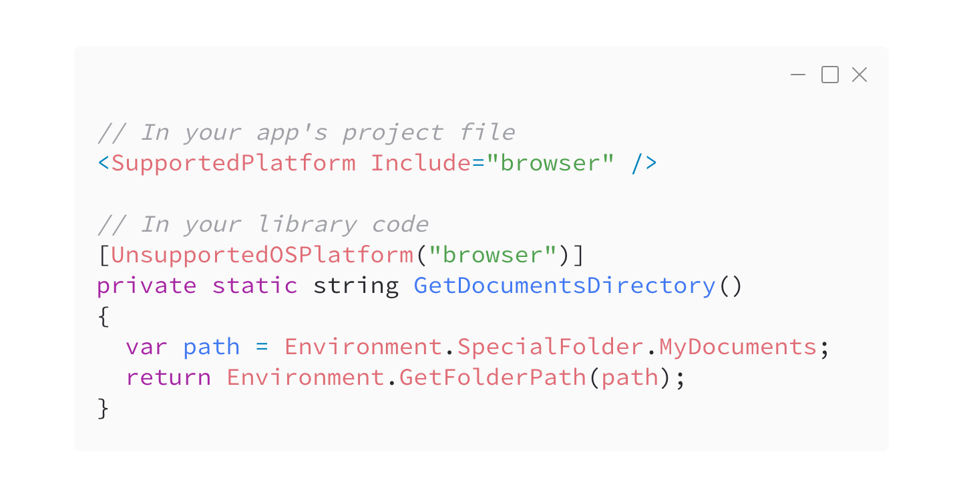
浏览器兼容性分析
Notes:
Safia to speak
With the server and WebAssembly hosting models, you can run Blazor on a variety of targets: from Linux and Windows servers to inside modern web browsers. In .NET 5, we shipped support for compatability analyzers that allow you to decorate your library's project file or APIs with information about supported platforms for an API. Now, instead of getting errors about unsupported APIs during runtime once you're application has already been deployed, you can get those warnings during development. Gone are the days of having to deal with extra headaches in production.

Slide 14
改进预渲染
Notes:
Safia to speak
Next in .NET 5, we shipped some improvements to the prerendering experience in Blazor. Pre-rendering is the process by which contents of a web page are compiled on the server and sent to the client as static HTML that is then made interactive later. Blazor currently supports a couple of render strategies that render pages statically then make them interactive via Blazor Server. In .NET 5, we shipped added some new render modes to the mix.

Slide 15
WebAssembly Prerendered
<component type="typeof(App)"
render-mode="WebAssemblyPrerendered" />
将组件预渲染为静态 HTML，并允许 Blazor WebAssembly 应用程序使组件具有交互性。
Notes:
Safia to speak
First, a WebAssemblyPrerendered mode which sents static HTML to the client, then makes it interactive later once Blazor WebAssembly has been loaded into the browser.

Slide 16
WebAssembly
<component type="typeof(App)" render-mode="WebAssembly" />
Enabled rendering Blazor WASM apps in MVC apps.
Notes:
Safia to speak
Second, a WebAssembly render mode which can be used to render Blazor WASM components into any existing MVC application. If this sounds like an intriguing idea to you, check out the Modern Web Development with Blazor & .NET 5 session with Javier and Dan later today to learn more.

Slide 17
延迟加载
<ItemGroup>
<BlazorWebAssemblyLazyLoad Include="BlazorTable.dll" />
</ItemGroup>
@inject LazyAssemblyLoader assemblyLoader
<Router AppAssembly="@typeof(Program).Assembly" OnNavigateAsync="@OnNavigateAsync">
...
</Router>
@code {
private async Task OnNavigateAsync(NavigationContext args) {
if (args.Path.EndsWith("notebooks")) {
await assemblyLoader.LoadAssembliesAsync(new List<string>() { "BlazorTable.dll" });
}
}
}
Notes:
Safia to speak
Prerendering is just one of the ways that you can improve startup performance for your application. Another is lazy-loading, which allows you to delay the loading of a particular assembly until it is needed, such as when a user visits a particular page. In .NET 5, we shipped support for lazy-loading via a new BlazorWebAssemblyLazyLoad build-time property that allows you to mark which assemblies to delay loading, a new LazyAssemblyLoader service which handles fetching the assemblies, computing integrity checks, and loading them into the debugger, and finally a new OnNavigateAsync API on the Router component that allows you to load assemblies via the service before loading the page. If this feature sounds useful to you, check out the Blazoract demo app and the official Blazor docs for getting started details.

Slide 18
其他改进
新的 InputRadio 组件
FocusAsync API
Custom component instantiation with IComponentActivator
Support for custom validation class names with FieldCssClassProvider
JavaScript isolation
Support for disposing components asynchronously
Support for optional and catch-all route parameters
Support for auth code flow with MSAL v2
New OffsetX and OffsetY properties to MouseEventArgs
Notes:
Steve: JavaScript isolation, FocusAsync
Safia: optional/catch-all route params, auth code flow

Slide 19

团队合作，实现梦想
.NET Runtime, VS Debugger, VS Code JavaScript Debugger, VS Web Tools, Azure Static Web Apps, Azure Functions
… 和 Blazor 社区

Slide 20
探讨微前端

Slide 21

Web 应用程序的进化
单体
SPA. BE/FE
微服务
微前端
单个系统(FE+BE)
FE
(SPA)
FE
(SPA)
1
2
N
App Shell
BE
(API)
Gateway
Gateway
1
2
N
1
2
N

Slide 22
系统架构示例
前端
单体架构
集成且一致的用户体验
由一个团队开发
大版本进行部署
Single Frontend Solution
微服务
围绕业务范围进行开发
由自主团队进行开发
自行开发和部署
松耦合
技术独立
Service A
Service B
Service C
Service X
Service Y

Slide 23
微前端架构
Distributed Web Application
前端
Frontend A
Frontend B
Frontend C
Frontend D
Microfrontend
后端
Service A
Service B
Service C
Service D
Microservice

Slide 24
推荐的前端架构
模块化的分布式Web应用程序
Distributed Web Application
前端
核心和通用功能
Frontend D
应用程序外壳组件
Frontend C
Module D
Frontend B
Module C
Frontend A
Module B
共享库
Module A
模式库
业务能力模块
后端
Service A
Service B
Service C
Service D
微服务

Slide 25


基于Blazor的微前端
使用 NuGet 包
模块化分布式Web应用程序
Blazor WASM App
Lib A
Lib B
Lib C
Lib D
Used Libs
Design Lib

Slide 26
基于Blazor的微前端
✅ 保持统一工作流
✅ 所有都基于C#
❌ 需要重新编译
❌ 没有跨框架支持
❌ 在开始之前需要全面评估

Slide 27




ant-design-blazor
交流群
移动开发和人工智能

Slide 28
Blazor在.NET5 有那些新特性
问题一

Slide 29
谈谈基于Blazor微前端的认识
问题二

Slide 30
ant-design-blazor
交流群
移动开发和人工智能

Slide 31
谢谢

